Slide 1
Thermodynamics Tutorial 2
Professor: Jay Wang
Teaching Assistants: Cameron Gillingham & Mahir Ashef Hridoy,

Slide 2

Question 1

Slide 3
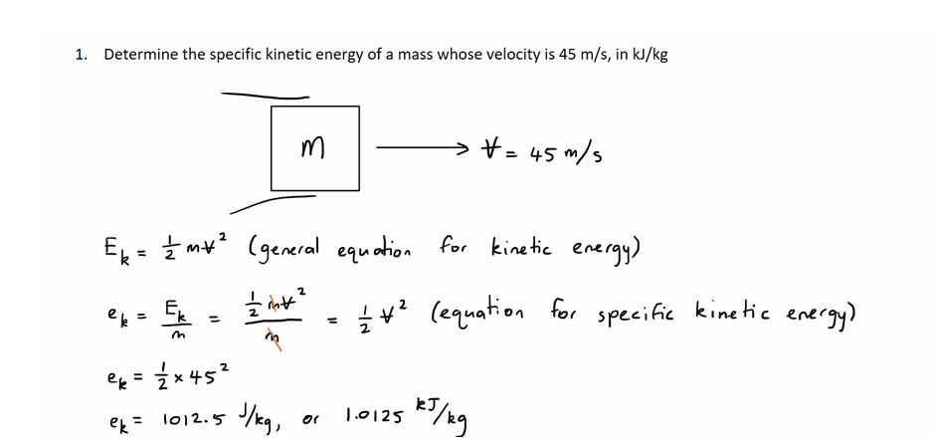
Question 1 Solution

Slide 4

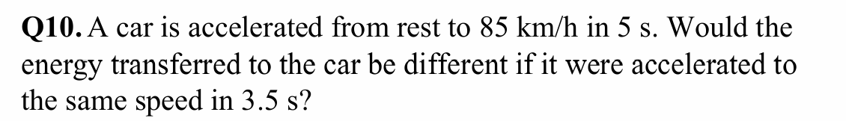
Question 2:

Slide 5
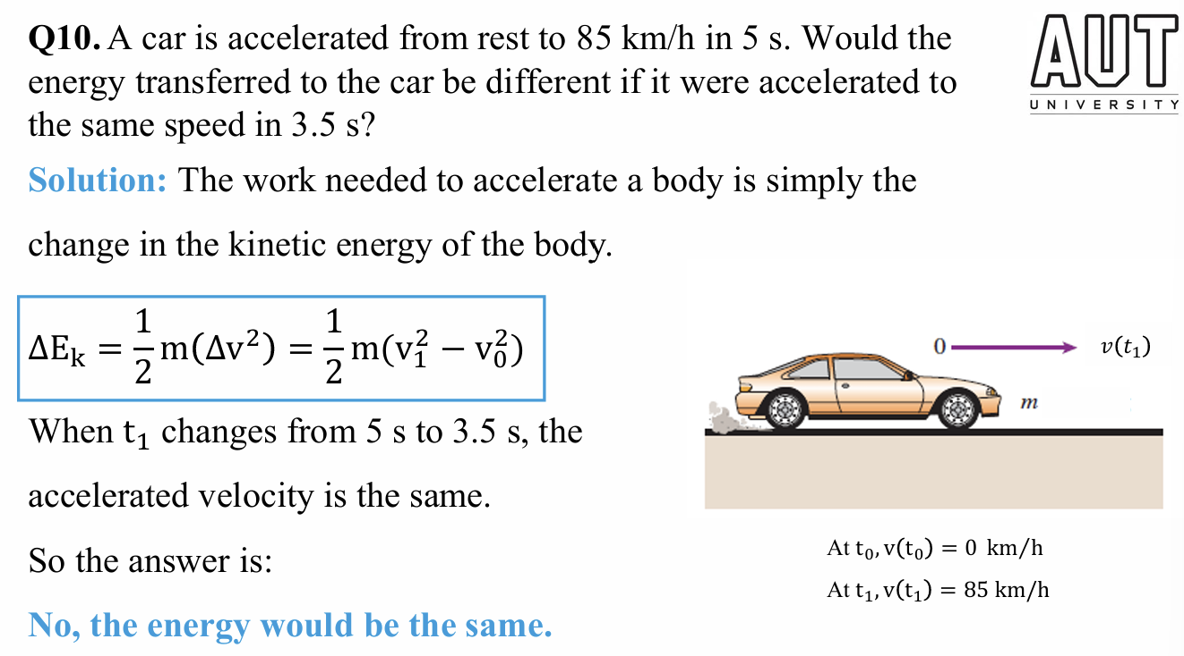
Question 2 Solution

Slide 6
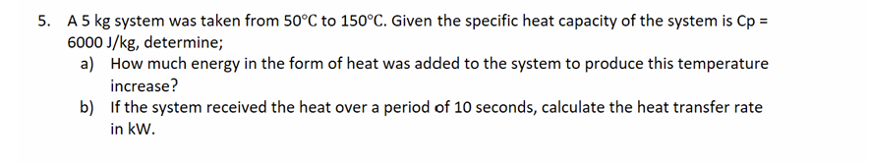
Question 3:

Slide 7
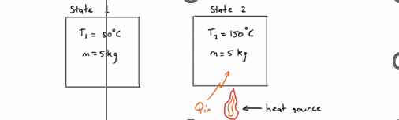
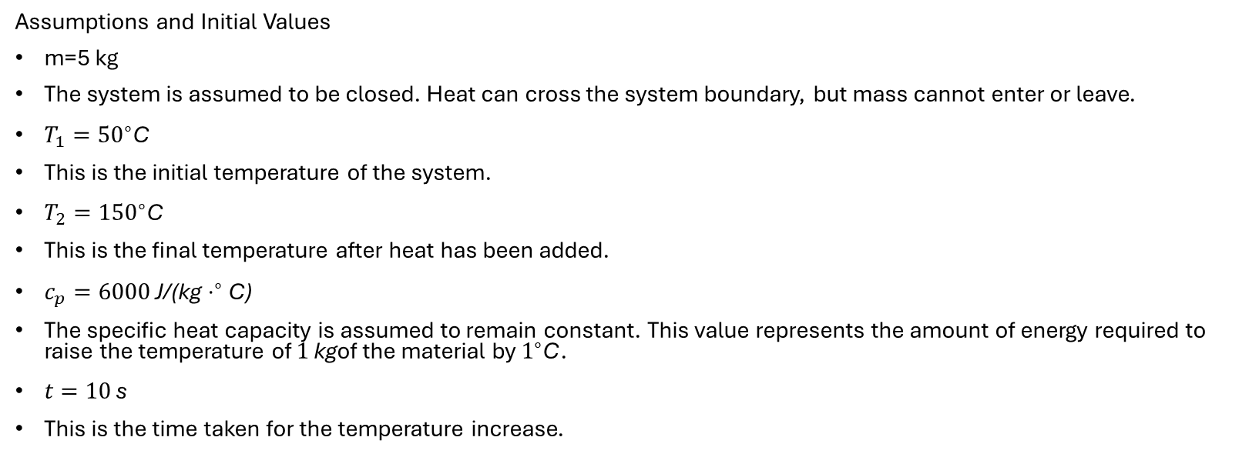
Question 3 Solution
Assumptions and Initial Values
m=5 kg
The system is assumed to be closed. Heat can cross the system boundary, but mass cannot enter or leave.
$T_{1}={50}^{∘}\text{C}$
This is the initial temperature of the system.
$T_{2}={150}^{∘}\text{C}$
This is the final temperature after heat has been added.
$c_{p}=6000 \text{J}\text{/(}\text{kg}⋅^{∘}\text{C}\text{)}$
The specific heat capacity is assumed to remain constant. This value represents the amount of energy required to raise the temperature of $1 \text{kg}$of the material by $1^{∘}\text{C}$.
$t=10 \text{s}$
This is the time taken for the temperature increase.

Slide 8
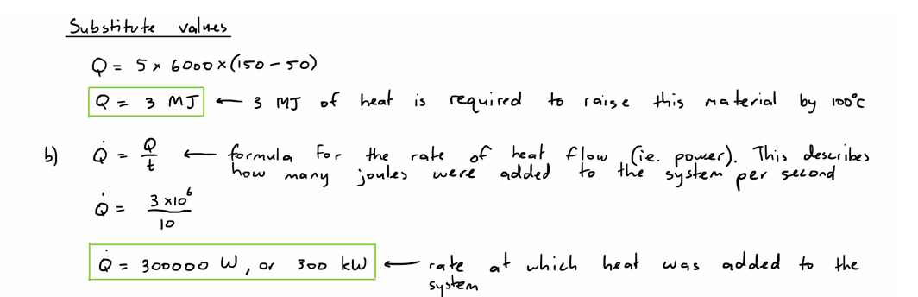

Question 3 Part b solution
$$Q=mc_{p}\left(T_{2}−T_{1}\right)$$

Slide 9
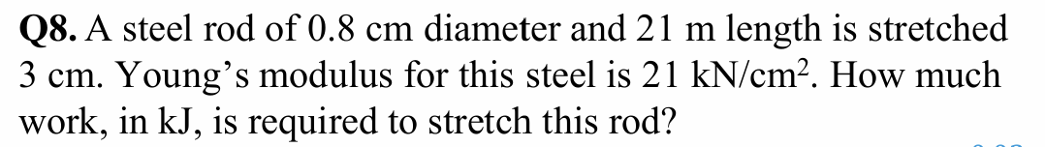
Question 4:

Slide 10
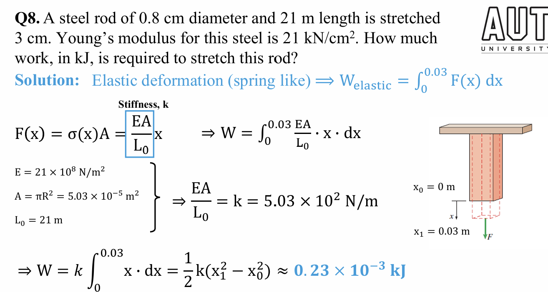
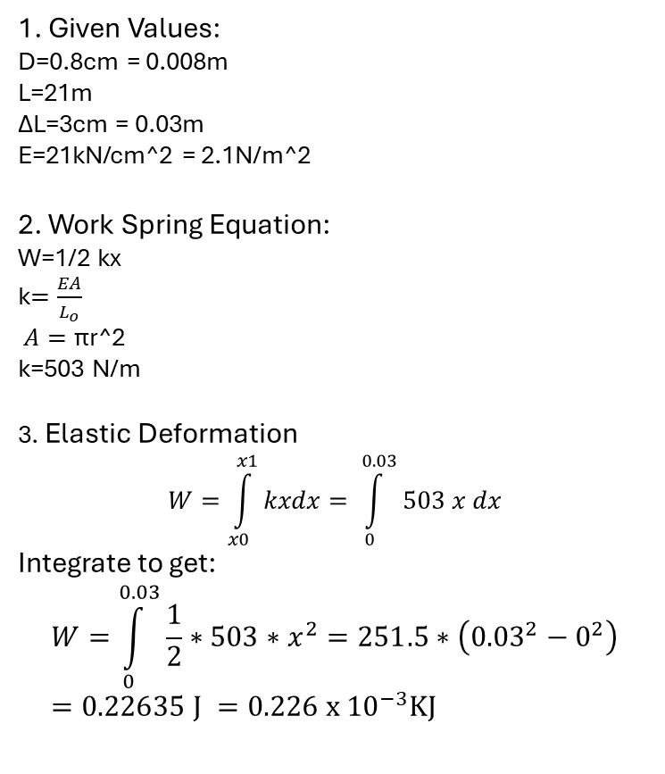
Question 4 Solution
1. Given Values:
D=0.8cm = 0.008m
L=21m
ΔL=3cm = 0.03m
E=21kN/cm^2 = 2.1N/m^2
2. Work Spring Equation:
W=1/2 kx
k$=\frac{EA}{L_{o}}$
$A=\text{π}\text{r}\text{^2}$
k=503 N/m
3. Elastic Deformation
$$W=\int_{x0}^{x1}{kxdx= \int_{0}^{0.03}{503 x dx}}$$
Integrate to get:
$$W=\int_{0}^{0.03}{\frac{1}{2}∗503∗x^{2}=251.5∗\left({0.03}^{2}−0^{2}\right)}=0.22635 J =0.226 x {10}^{−3}KJ$$

Slide 11
Question 5:

Slide 12
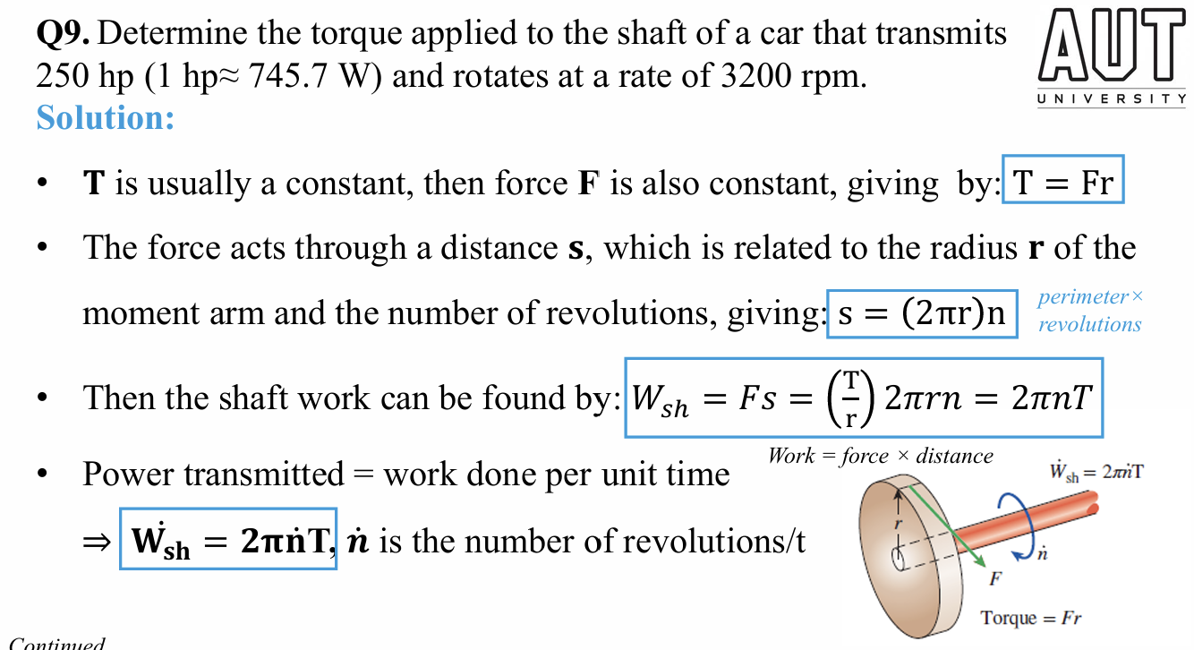
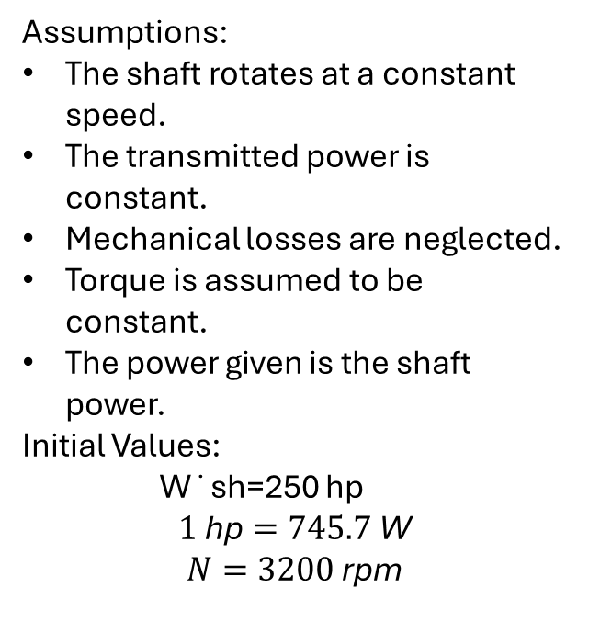
Question 5 Solution
Assumptions:
The shaft rotates at a constant speed.
The transmitted power is constant.
Mechanical losses are neglected.
Torque is assumed to be constant.
The power given is the shaft power.
Initial Values:
W˙sh​=250 hp
$$1 \text{hp}=745.7 \text{W}$$
$$N=3200 \text{rpm}$$

Slide 13
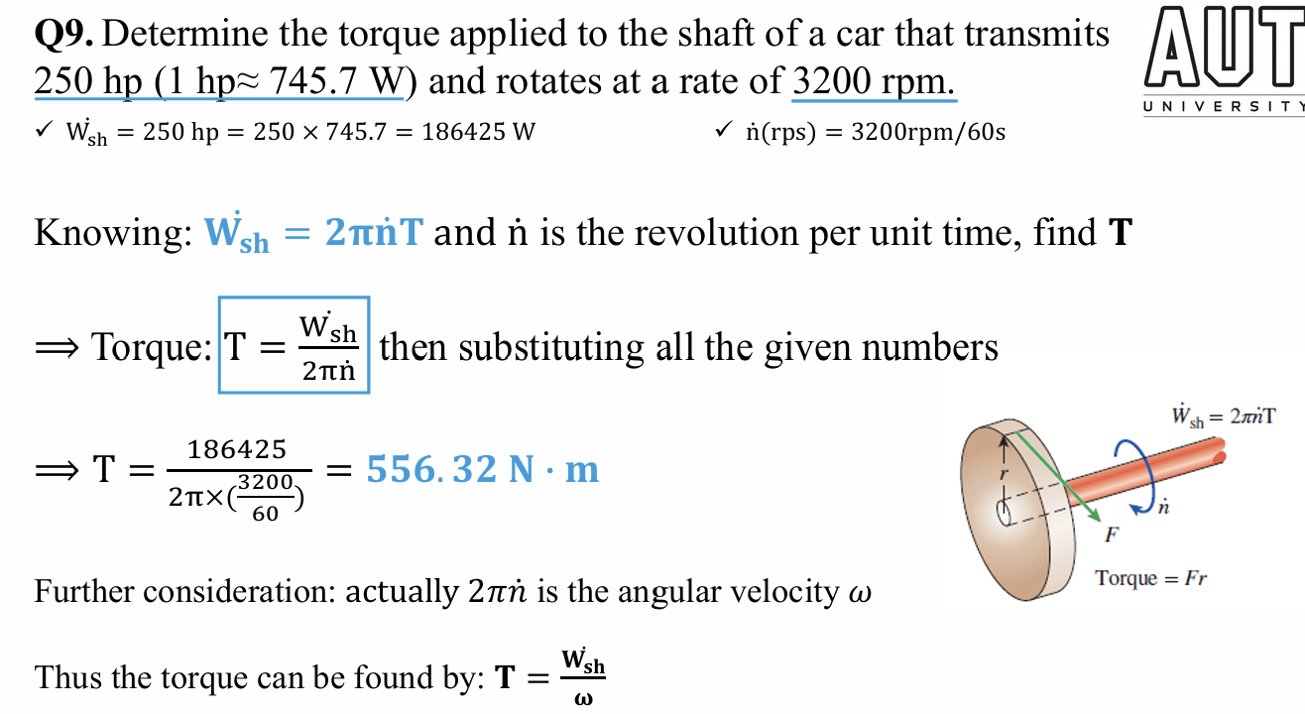
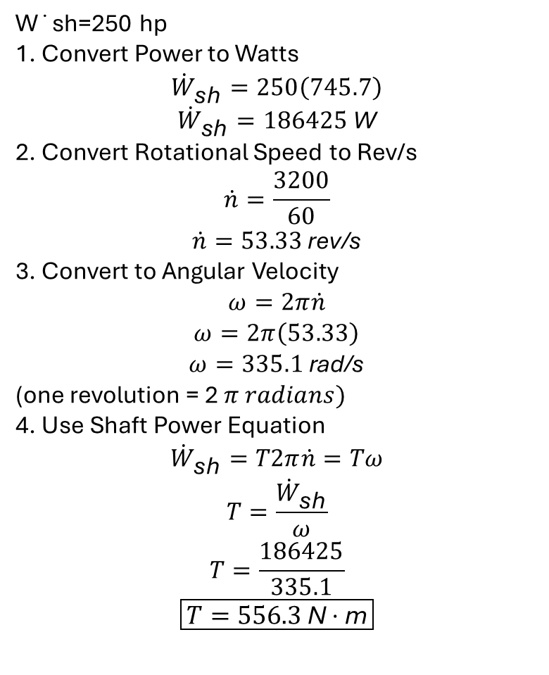
Question 5 Solution Continued
W˙sh​=250 hp
1. Convert Power to Watts
$${\dot{W}}_{\text{sh}}=250\left(745.7\right)$$
$${\dot{W}}_{\text{sh}}=186425 \text{W}$$
2. Convert Rotational Speed to Rev/s
$$\dot{n}=\frac{3200}{60}$$
$$\dot{n}=53.33 \text{rev}\text{/}\text{s}$$
3. Convert to Angular Velocity
$$ω=2π\dot{n}$$
$$ω=2π\left(53.33\right)$$
$$ω=335.1 \text{rad}\text{/}\text{s}$$
(one revolution = 2 $π radians)$
4. Use Shaft Power Equation
$${\dot{W}}_{\text{sh}}=T2π\dot{n}=Tω$$
$$T=\frac{{\dot{W}}_{\text{sh}}}{ω}$$
$$T=\frac{186425}{335.1}$$
$$\boxed{T=556.3 \text{N}⋅\text{m}}$$

Slide 14
Question 6:

Slide 15
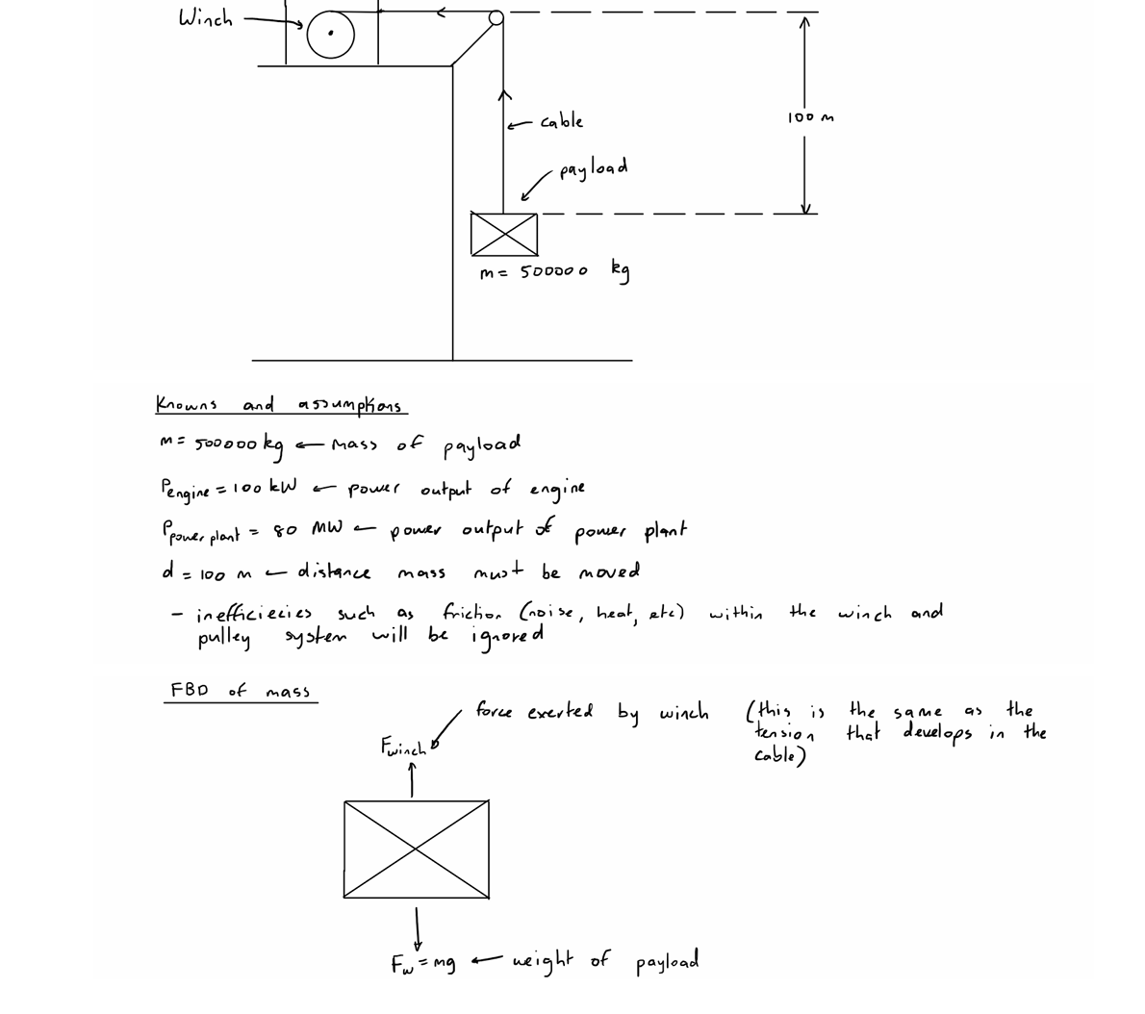
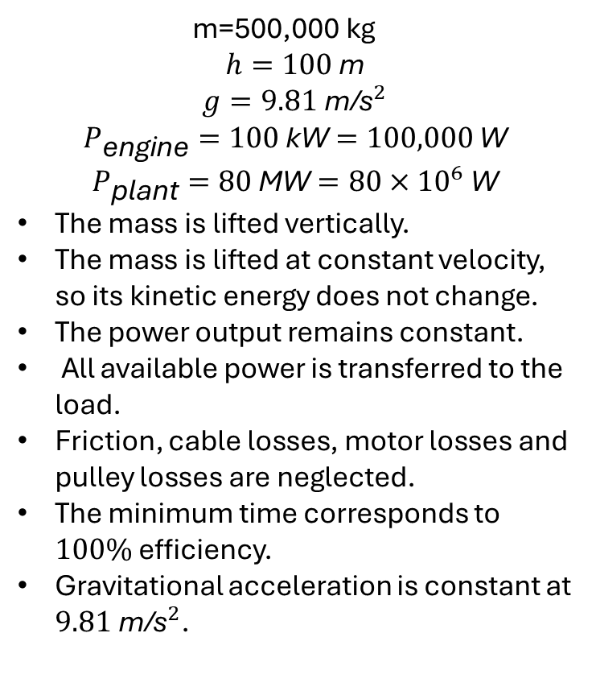
Question 6 Solution
m=500,000 kg
$$h=100 \text{m}$$
$$g=9.81 {\text{m}\text{/}\text{s}}^{2}$$
$$P_{\text{engine}}=100 \text{kW}=100,000 \text{W}$$
$$P_{\text{plant}}=80 \text{MW}=80×{10}^{6} \text{W}$$
The mass is lifted vertically.
The mass is lifted at constant velocity, so its kinetic energy does not change.
The power output remains constant.
All available power is transferred to the load.
Friction, cable losses, motor losses and pulley losses are neglected.
The minimum time corresponds to $100\%$efficiency.
Gravitational acceleration is constant at $9.81 {\text{m}\text{/}\text{s}}^{2}$.

Slide 16
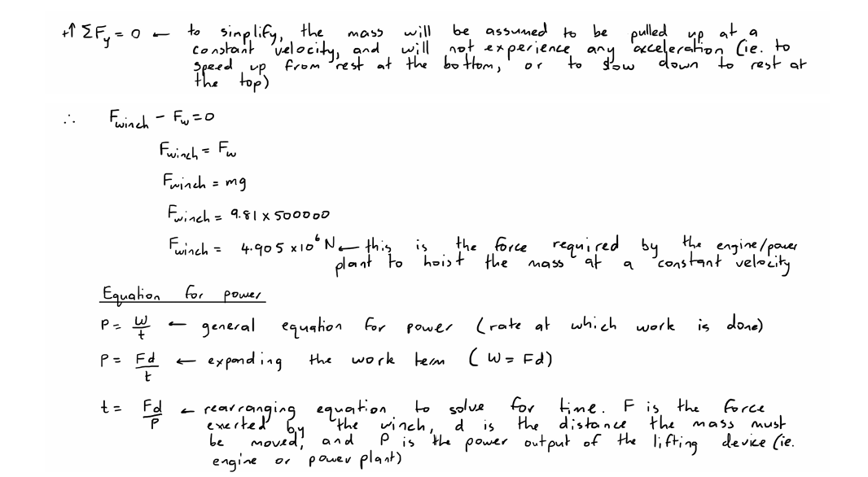
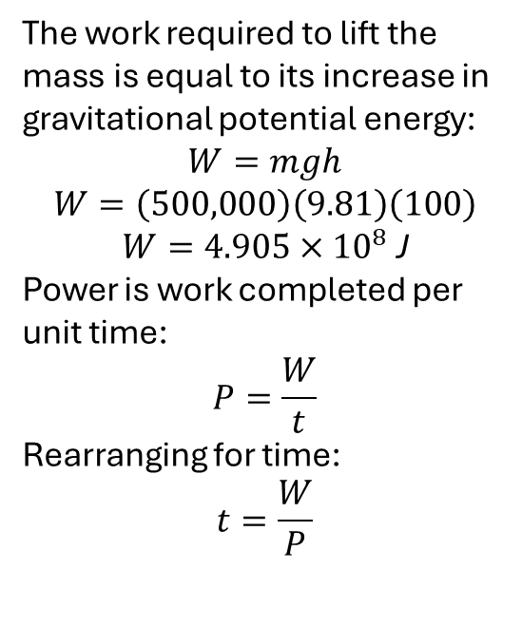
Question 6 Solution Continued
The work required to lift the mass is equal to its increase in gravitational potential energy:
$$W=mgh$$
$$W=\left(500,000\right)\left(9.81\right)\left(100\right)$$
$$W=4.905×{10}^{8} \text{J}$$
Power is work completed per unit time:
$$P=\frac{W}{t}$$
Rearranging for time:
$$t=\frac{W}{P}$$

Slide 17
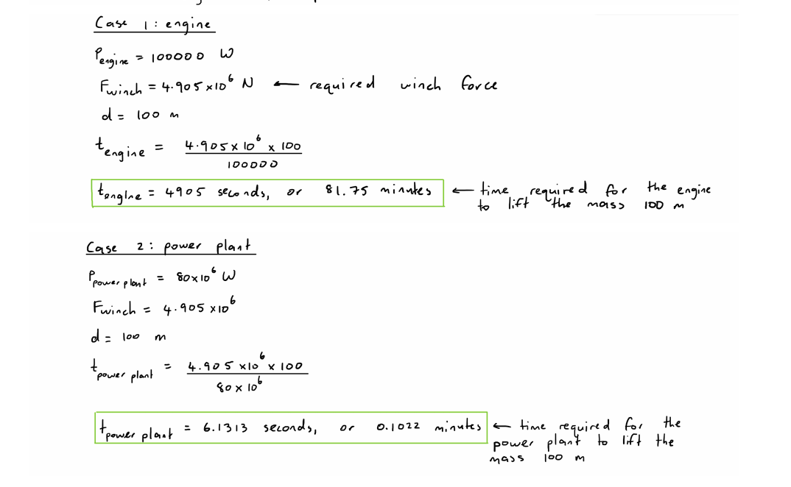
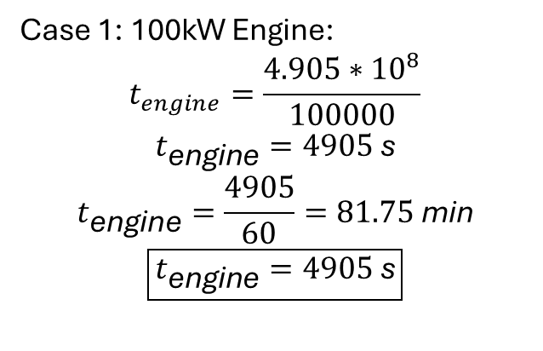
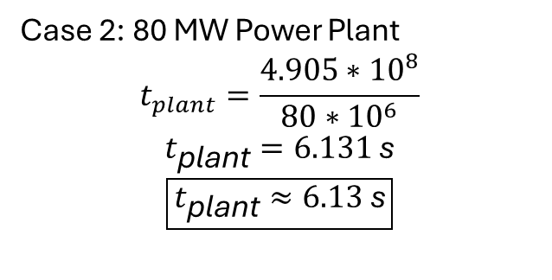
Question 6 Solution Continued
Case 1: 100kW Engine:
$$t_{engine}=\frac{4.905∗{10}^{8}}{100000}$$
$$t_{\text{engine}}=4905 \text{s}$$
$$t_{\text{engine}}=\frac{4905}{60}=81.75 \text{min}$$
$$\boxed{t_{\text{engine}}=4905 \text{s}}$$
Case 2: 80 MW Power Plant
$$t_{plant}=\frac{4.905∗{10}^{8}}{80∗{10}^{6}}$$
$$t_{\text{plant}}=6.131 \text{s}$$
$$\boxed{t_{\text{plant}}≈6.13 \text{s}}$$

Slide 18
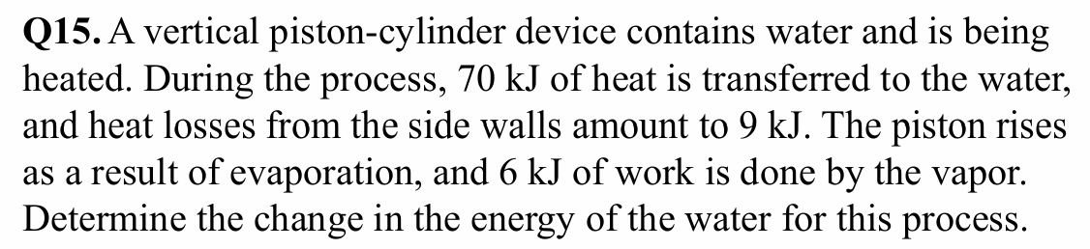
Question 7:

Slide 19
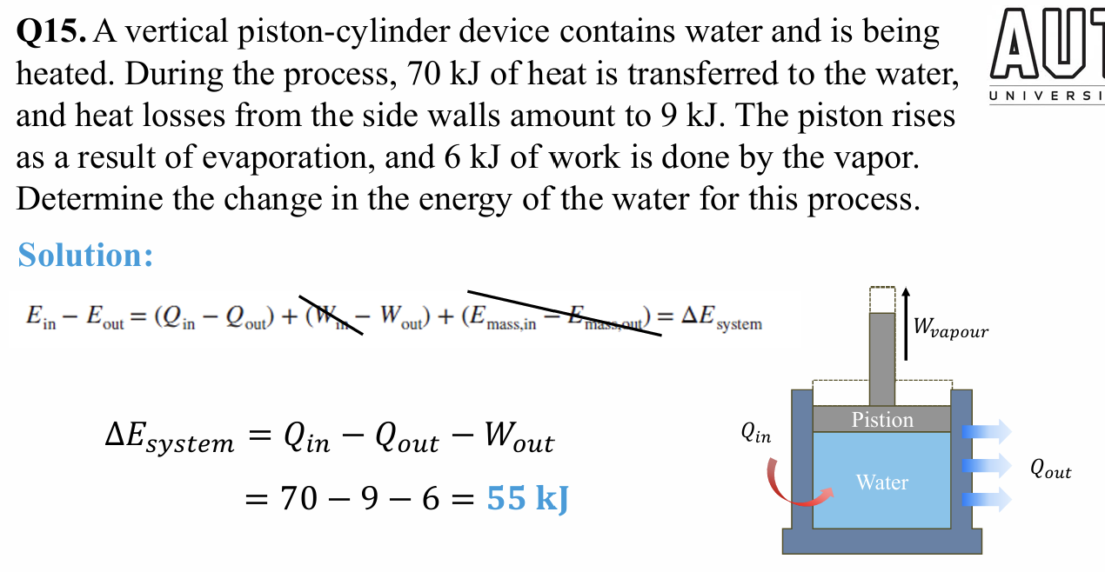
Question 7 Solution

Slide 20
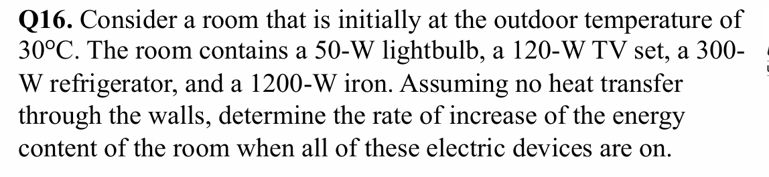
Question 8

Slide 21
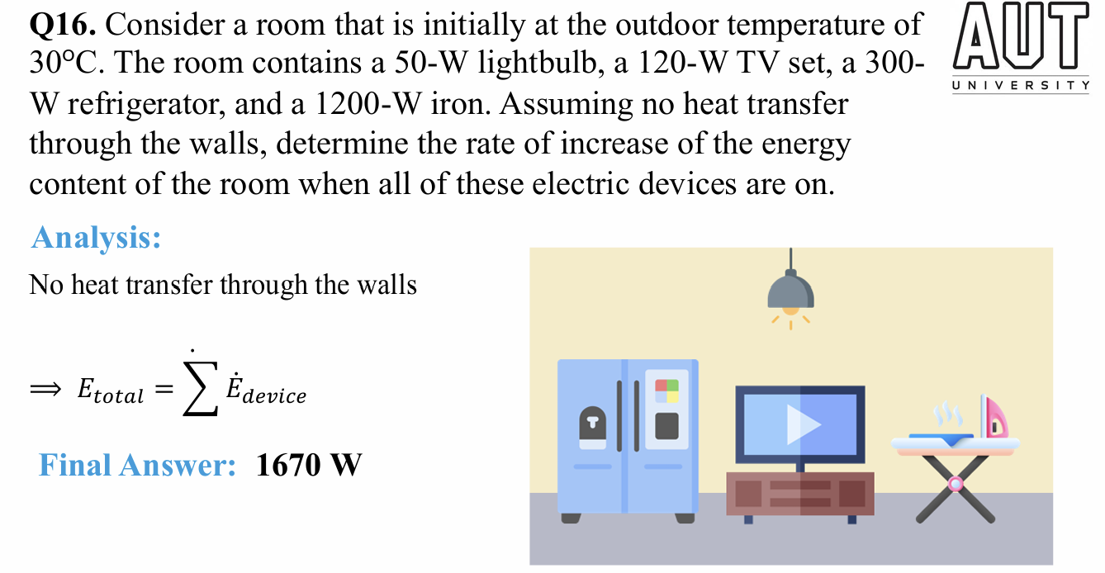
Question 8 Solution

Slide 22
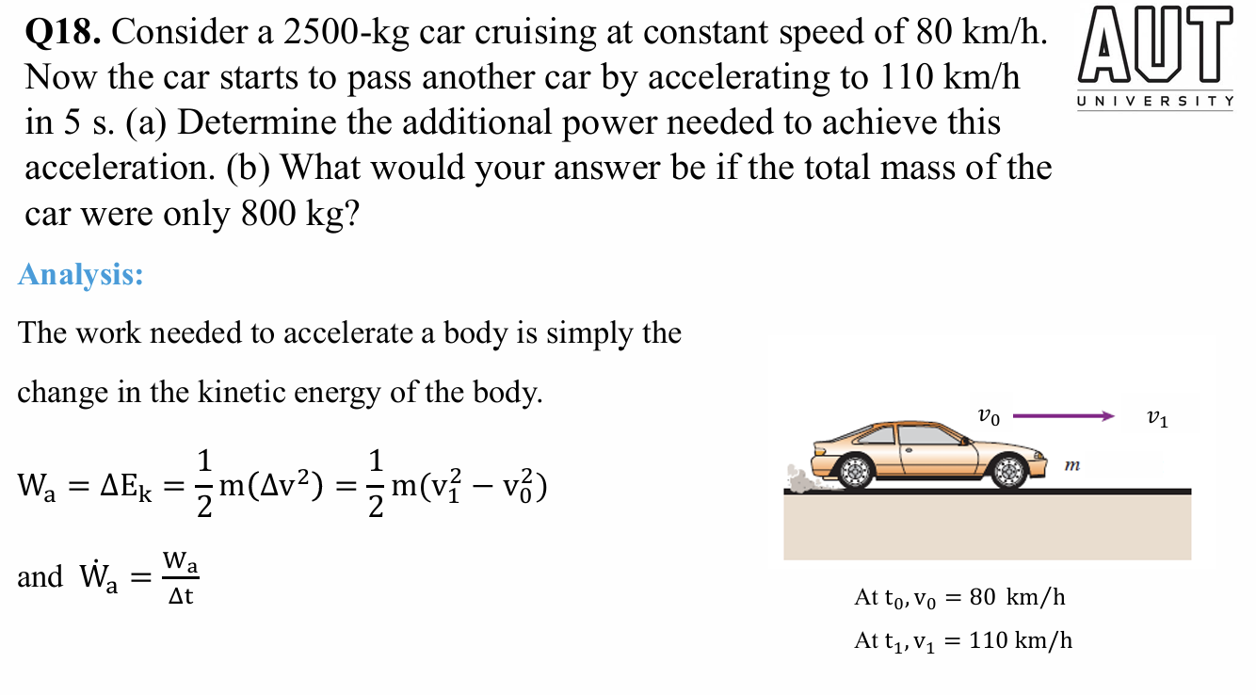
Question 9:

Slide 23
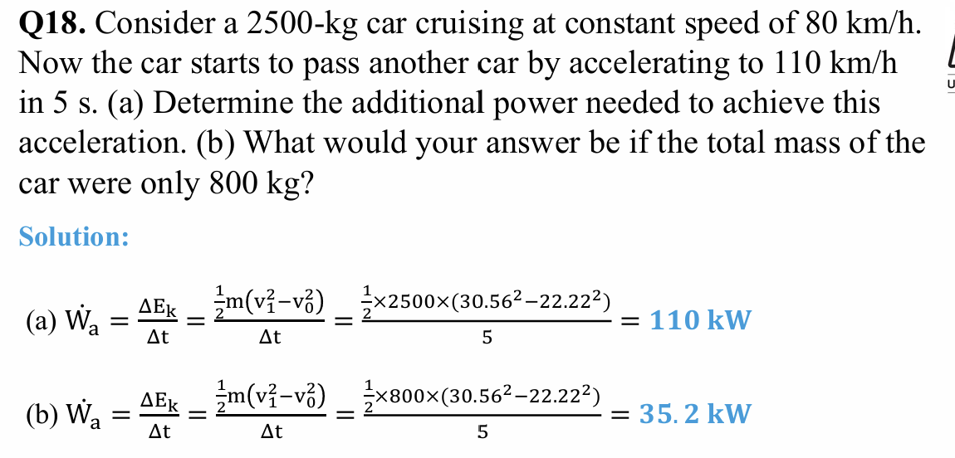
Question 9 Solution

Slide 24
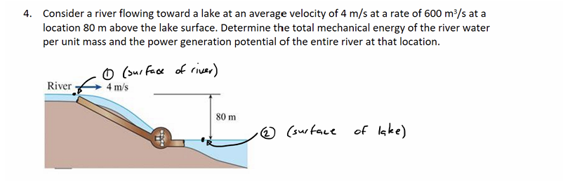
Question 10:

Slide 25

Question 10 Solution
Assumptions:
Both selected points are open to the atmosphere, so P₁ = P₂ = P_atm and the pressure-energy terms cancel.
The lake is large and state 2 is selected far from the outlet, so V₂ ≈ 0 m/s. (Lakes do not move)
Take the lake surface as the elevation datum: z₂ = 0 m and z₁ = 80 m.
Water is incompressible with ρ = 1000 kg/m³.
The power potential is the theoretical maximum: turbine inefficiency and frictional losses are neglected.
Given: V₁ = 4 m/s,
V̇ = 600 m³/s, volumetric flow rate
z₁ − z₂ = 80 m,
ρ = 1000 kg/m³

Slide 26
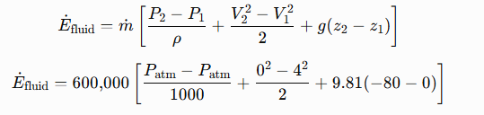
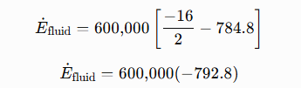

Question 10 Solution Continued
Mass flow rate
ṁ = ρV̇ -> mass flow rate is equal to volumetric flow rate times density
= (1000)(kg/m^3)(600)(m^3/s)
= 600,000 kg/s
Since both pressure are Patm, change in pressure is zero
Efluid is power lost by water as it passes through turbine, so Emech is power gained by turbine as water spins it.

